Slide 1
MCQS
POINTERS, STRUCTURES, ARRAYS, DMA

Slide 2
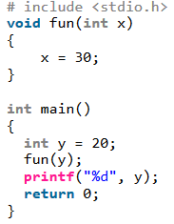
Q:1. What is the output of following program?
A.20
B. 30
C. Compile time error
D. Run time error
Solution: A

Slide 3
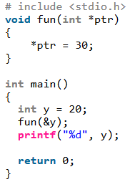
Q:2. Output of following program?
A.20
B. 30
C. Compile time error
D. Run time error
Solution: B
In the statement ‘*ptr = 30’, value at address ptr is changed to 30. The address operator & is used to get the address of a variable of any data type. In the function call statement ‘fun(&y)’, address of y is passed so that y can be modified using its address.

Slide 4
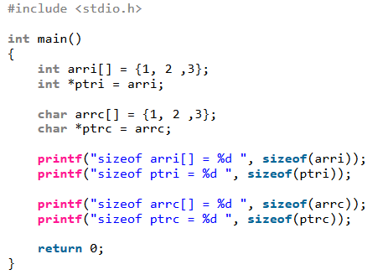
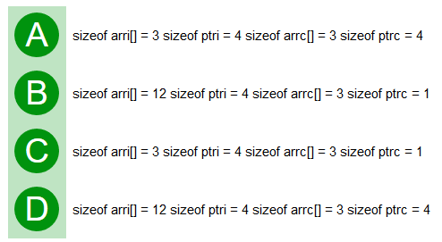
Q:3. Consider a compiler where int takes 4 bytes, char takes 1 byte and pointer takes 4 bytes.
Solution: D Size of an array is number of elements multiplied by the type of element, that is why we get sizeof arri as 12 and sizeof arrc as 3. Size of a pointer is fixed for a compiler. All pointer types take same number of bytes for a compiler. That is why we get 4 for both ptri and ptrc.

Slide 5
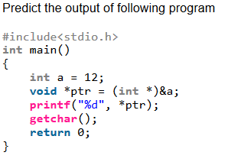
Q:4.
A. 12
B. Compile time error
C. Run time error
D. 0
Solution: B
There is compiler error in line "printf("%d", *ptr);". void * type pointers cannot be de-referenced. We must type cast them before de-referencing. The following program works fine and prints 12.
int main()
{
int a = 12;
void *ptr = (int *)&a;
printf("%d", *(int *)ptr);
getchar();
return 0;
}

Slide 6
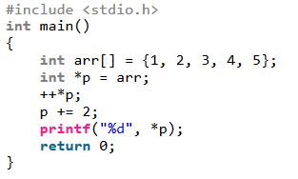
Q:5.
A. 2
B. 3
C. 4
D. Compile time error
Solution: B The expression ++*p is evaluated as "++(*p)" . So it increments the value of first element of array (doesn't change the pointer p). When p += 2 is done, p is changed to point to third element of array.

Slide 7
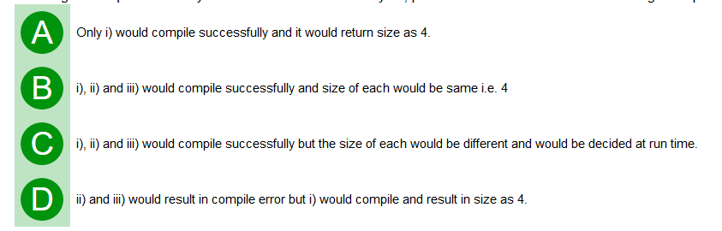
Q:6. Suppose that in a C program snippet, followings statements are used. i) sizeof(int); ii) sizeof(int*); iii) sizeof(int**);
Assuming size of pointer is 4 bytes and size of int is also 4 bytes, pick the most correct answer from the given options.
Solution: B

Slide 8
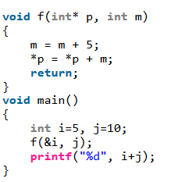
Q:7. The value printed by the following program is :
A. 10
B. 20
C. 30
D. 40
Solution: C . For i, address is passed. For j, value is passed. So in function f, p will contain address of i and m will contain value 10. 1st statement of f() will change m to 15. Then 15 will be added to value at address p. It will make i = 5+15 = 20. j will remain 10. print statement will print 20+10 = 30. So answer is C.

Slide 9
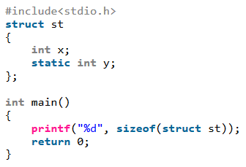
Q:8. Assume that size of an integer is 32 bit. What is the output of following program?
A. 4
B. 8
C. Compile time error
D. Run time error
Solution: C In C, struct and union types cannot have static members. In C++, struct types are allowed to have static members, but union cannot have static members in C++ also.

Slide 10
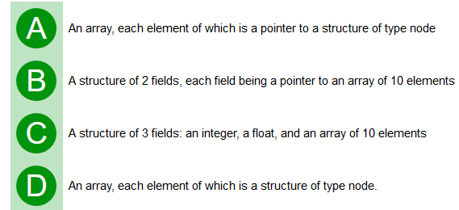
Q:9. struct node
{ int i; float j;
}; struct node *s[10];
The above C declaration define 's' to be:
Solution: A

Slide 11
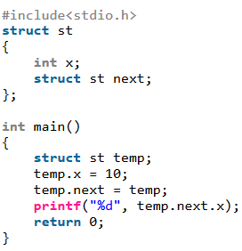
Q:10.
A. Compile time error
B. 10
C. Run time error
D. Garbage value
Solution: A A structure cannot contain a member of its own type because if this is allowed then it becomes impossible for compiler to know size of such struct. Although a pointer of same type can be a member because pointers of all types are of same size and compiler can calculate size of struc

Slide 12
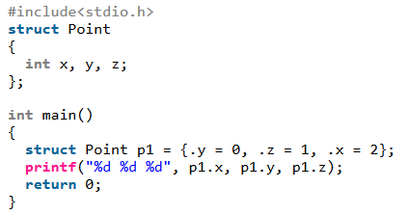
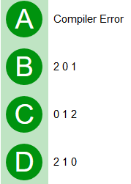
Q:11. Predict the output of following C program:
Solution: B

Slide 13
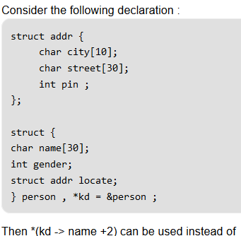
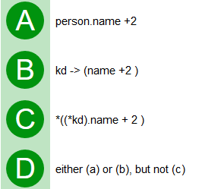
Q:12.
Solution: A

Slide 14
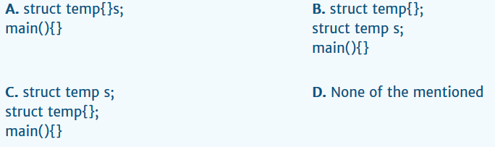
Q:13. Which of the following structure declaration will throw an error?
Solution: D

Slide 15
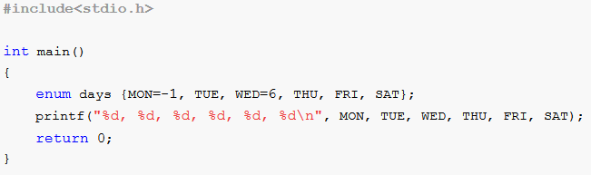
Q:14. What will be the output of the program ?
A. | -1, 0, 1, 2, 3, 4
B. | -1, 2, 6, 3, 4, 5
C. | -1, 0, 6, 2, 3, 4
D. | -1, 0, 6, 7, 8, 9
Solution: D

Slide 16
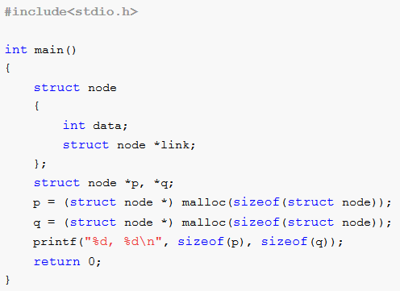
Q:15. What will be the output of the program in 16-bit platform?
A. | 2, 2
B. | 8, 8
C. | 5, 5
D. | 4, 4
Solution: A

Slide 17
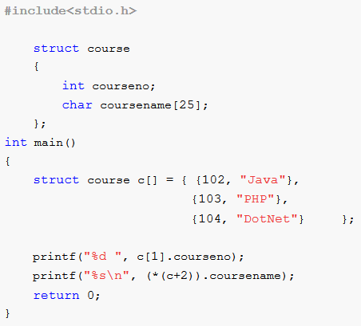
Q:16. What will be the output of the program ?
A. | 103 DotNet
B. | 102 Java
C. | 103 PHP
D. | 104 DotNet
Solution: A

Slide 18

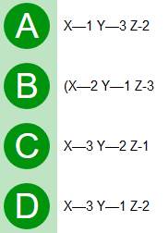
Q:17. The most appropriate matching for the following pairs:
Solution: D X -> A pointer is assigned to NULL without freeing memory so a clear example of memory leak Y -> Trying to retrieve value after freeing it so dangling pointer. Z -> Using uninitialized pointers

Slide 19
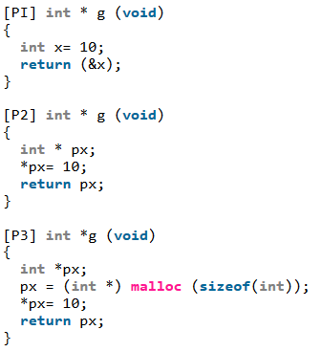
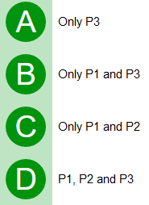
Q:18. Consider the following three C functions. Which of the above three functions are likely to cause problems with pointers?
Solution: C

Slide 20
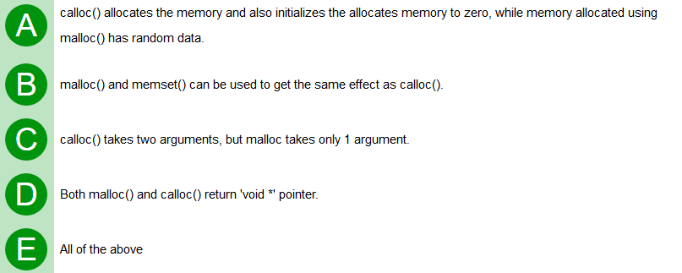
Q:19. Which of the following is/are true?
Solution: E

Slide 21
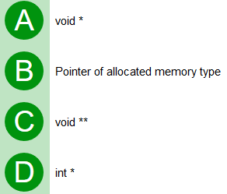
Q:20. What is the return type of malloc() or calloc()?
Solution: A malloc() and calloc() return void *. We may get warning in C if we don't type cast the return type to appropriate pointer

Slide 22
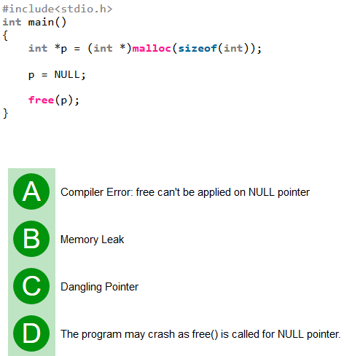
Q:21. What is the problem with following code?
Solution: B free() can be called for NULL pointer, so no problem with free function call. The problem is memory leak, p is allocated some memory which is not freed, but the pointer is assigned as NULL. The correct sequence should be following: free(p);
p = NULL;

Slide 23
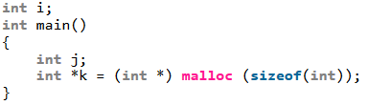
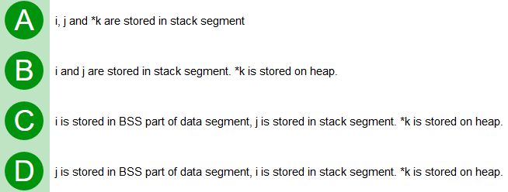
Q:22. Consider the following program, where are i, j and k are stored in memory?
Solution: C

Slide 24
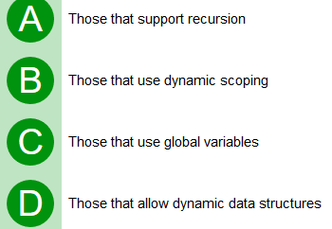
Q:23. Which languages necessarily need heap allocation in the run time environment?
Solution: D

Slide 25
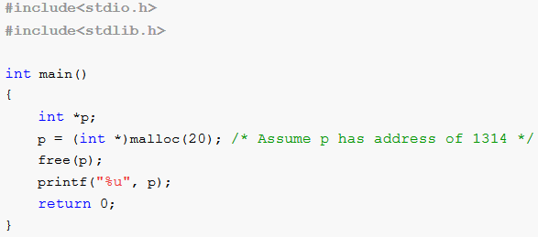
Q:24. What will be the output of the program?
A. | 1314
B. | Garbage value
C. | 1316
D. | Random address
Solution: A

Slide 26
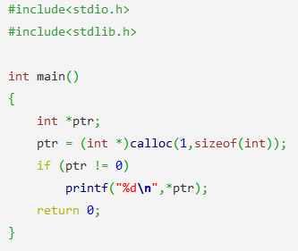
Q:25. What is the output of this program?
a) 0
b) -1
c) garbage value
d) none of the mentioned
Solution: a
Explanation: The memory allocated by calloc() contains 0 until process does not make any change to it.

Slide 27
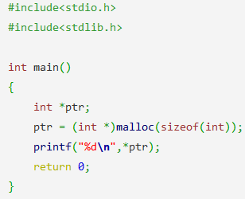
Q:26. What is the output of this program?
a) 4
b) -1
c) undefined
d) none of the mentioned
Solution: c
Explanation: The content of the memory block allocated by malloc() is undefined.

Slide 28
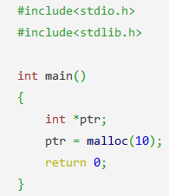
Q:27. In this program the allocated memory block can store:
a) int
b) char
c) float
d) all of the mentioned
Solution: d
Explanation: When the malloc() is used without typecasting the default type is void*.

Slide 29
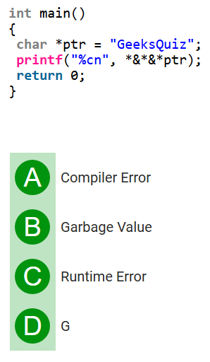
28.
Sol: D
The operator * is used for dereferencing and the operator & is used to get the address. These operators cancel out effect of each other when used one after another. We can apply them alternatively any no. of times. In the above code, ptr is a pointer to first character of string g. *ptr gives us g, &*ptr gives address of g, *&*ptr again g, &*&*ptr address of g, and finally *&*&*ptr gives ‘g’

